Slide 1


Microsoft Power BI Module 8 - Power BI Premium

Slide 2
Introduction to Power Bl Premium

Slide 3
What is Power Bl Premium?
Introduction to Power Bl Premium
Power BI currently has three versions:
Microsoft Power BI Free / Desktop
Microsoft Power BI Pro
Microsoft Power BI Premium

Slide 4
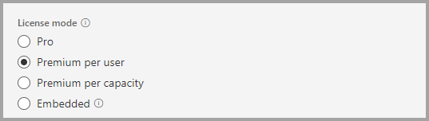
Power Bl Premium Per User
Introduction to Power Bl Premium
Power Bl Premium Per User allows organizations to license Premium features on a per-user basis.
Premium Per User (PPU) includes all Power Bl Pro license capabilities, and also adds features such as paginated reports, Al, and other capabilities that are only available to Premium subscribers.

Slide 5
Introduction to Power Bl Premium
Power Bl Premium Features
Greater scale and performance for your Power Bl reports
Flexibility to license by capacity
Best-in-class features for data visualization and insight-extraction such as Al-driven analysis, reusable Data Flows, and paginated reports
Unify self-service and enterprise Bl with a variety of Premium-only capabilities that support heavier workloads and require enterprise scale
Built-in license to extend on-premises Bl with Power Bl Report Server
Ability to share Power Bl content with anyone (even outside your organization).

Slide 6
Introduction to Data Flow

Slide 7
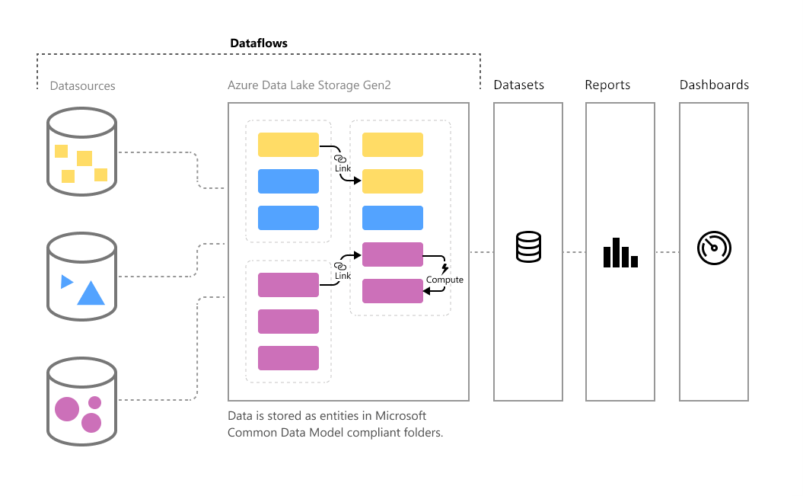
Introduction to Data Flow
A Data Flow is a collection of tables that are created and managed in workspaces in the Power Bl service.
Power Bl Data Flow is the data transformation component in Power Bl Service.
It is a Power Query process that runs in the cloud (PBI Service), independent from Power Bl report and dataset, and store the data into CDM: Common Data Model inside Azure Data Lake storage.

Slide 8
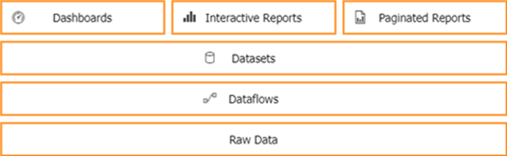
Introduction to Data Flow
Power Bl Data Flow, you can develop do-it-yourself ETL processes, which you can use to connect with business data from various data sources.
In no time you can start your own Proof of Concept and share Datasets with other people.
Power Bl Data Flow is NOT a replacement for your company Data Warehouse

Slide 9
Creating a Data Flow

Slide 10
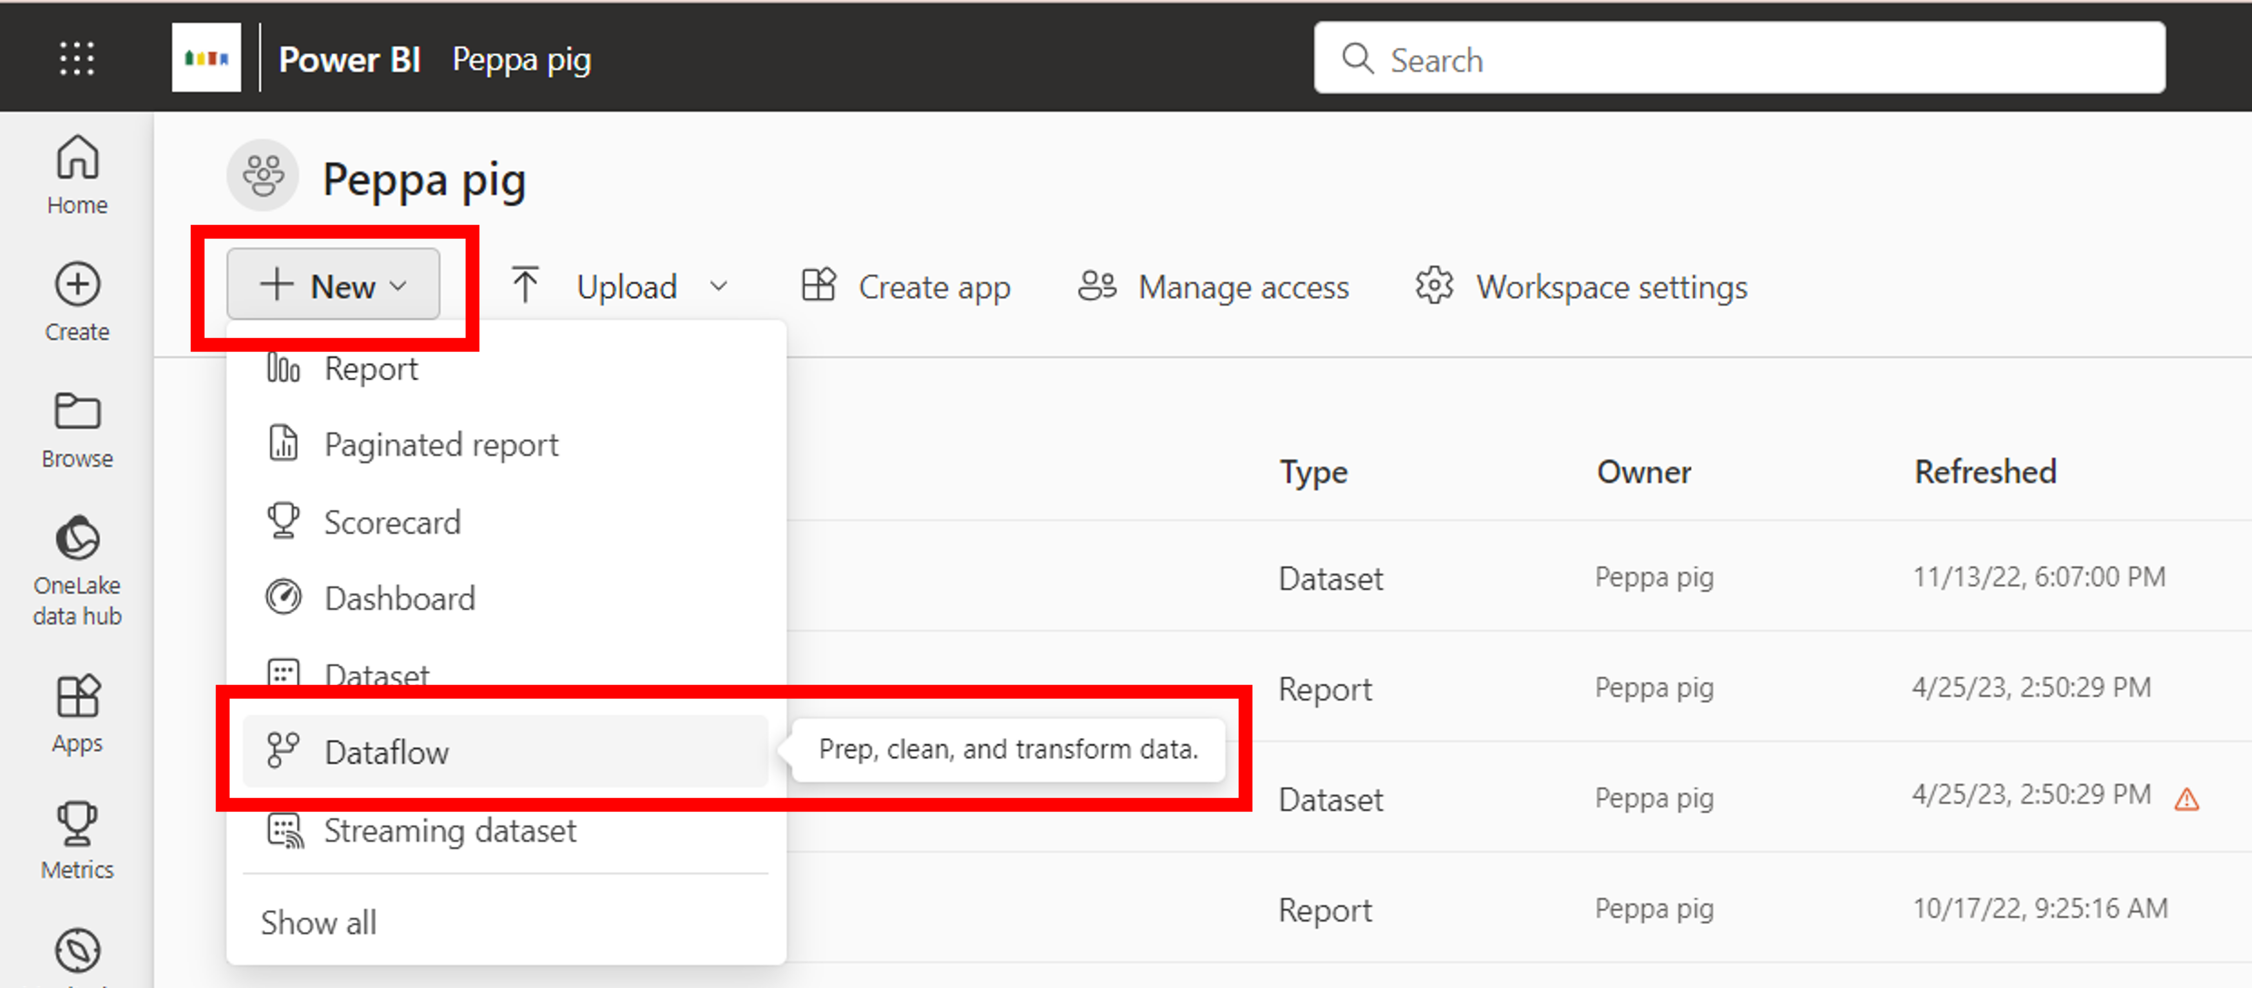
Creating a Data Flow
So how to create Data Flow?
In Powerbi.com portal go to Workplace Data Flows.
Create new Data Flow:

Slide 11
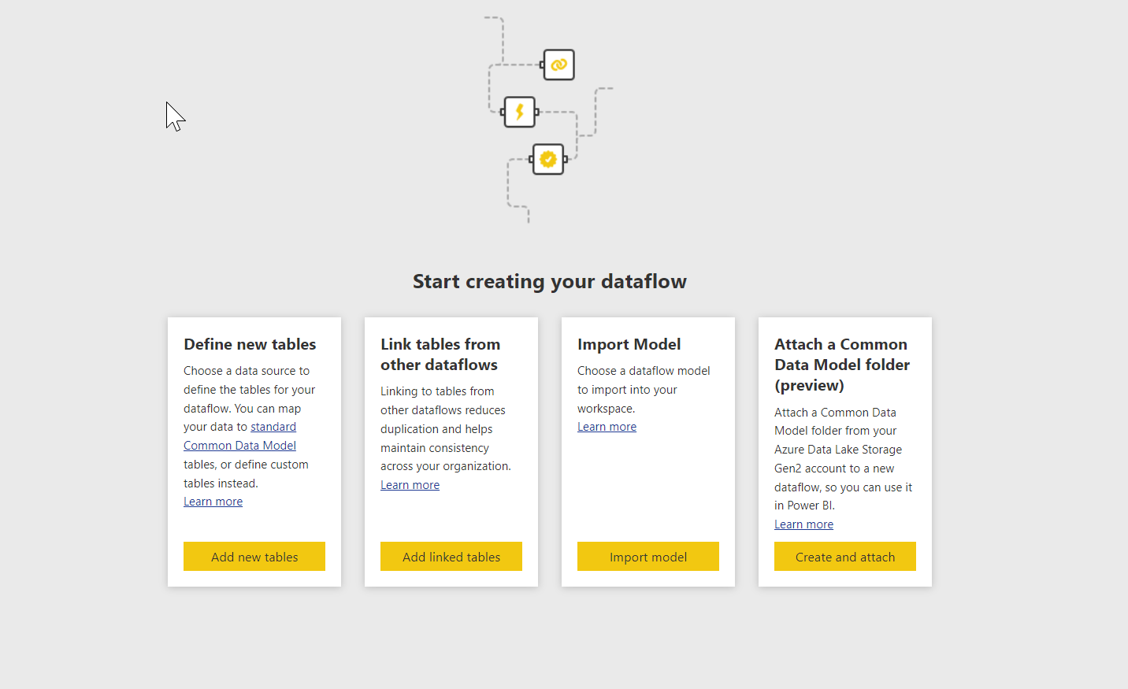
Creating a Data Flow
• Select Define new entities/tables Add new entities/table

Slide 12
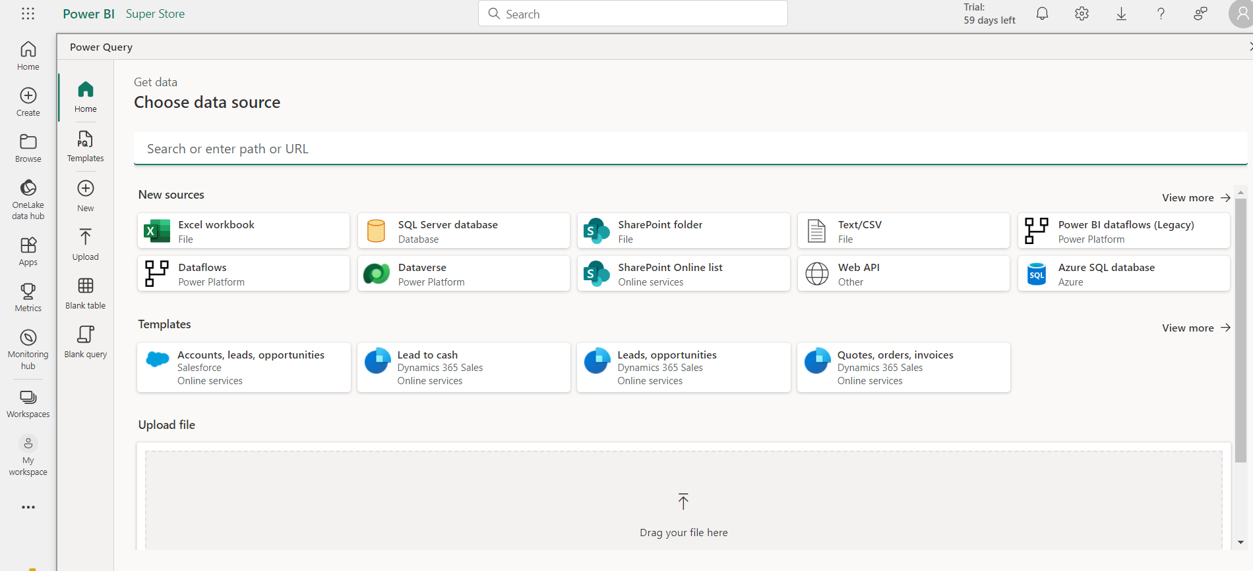
Creating a Data Flow
• For demonstration, let's use Web API - some webpage with no
authorization, no gateway, etc.:

Slide 13
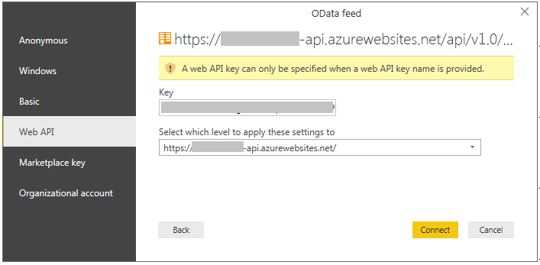
Creating a Data Flow
In this example let's use this exchange rate list:
http://www.cnb.cz/cs/financni_trh/_devizoveho_trhu/kurzy devizoveho trhu/rok.txt?rok=2019

Slide 14
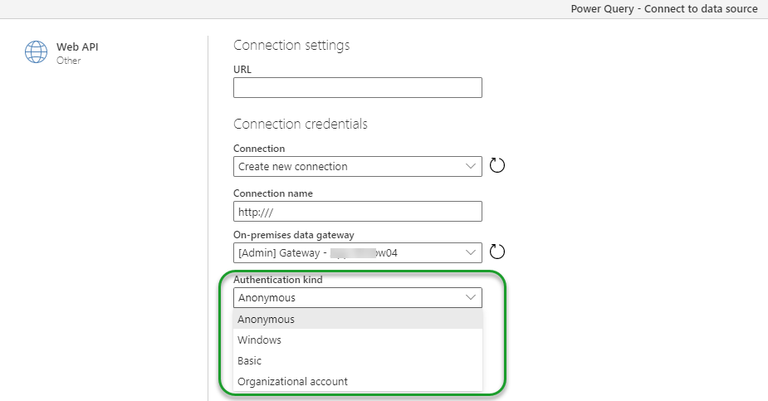
Creating a Data Flow
In next step we appeared in an interesting environment, similar to power BI Query editor:
You can simply modify tables here.

Slide 15
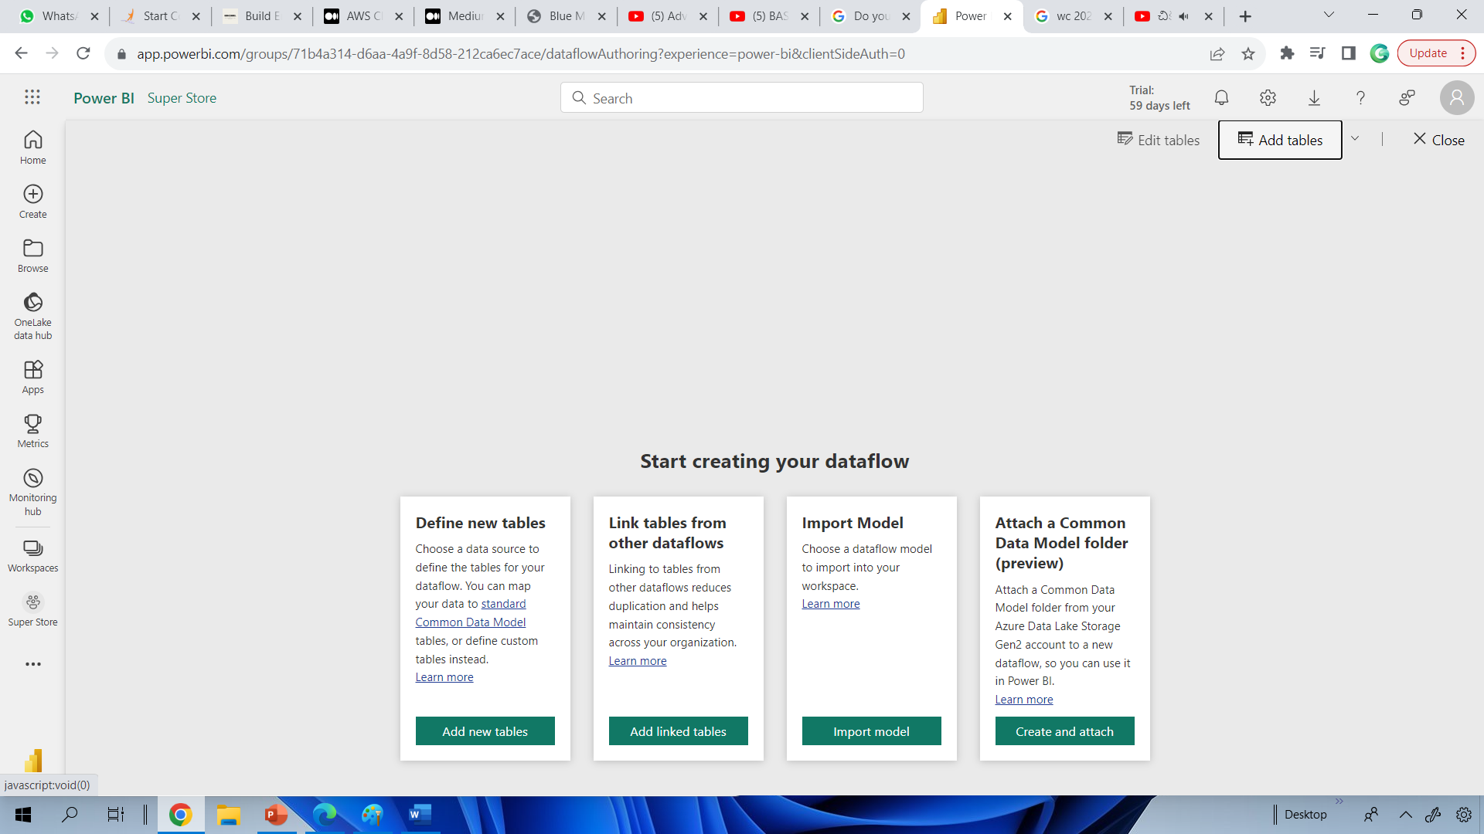
Creating a Data Flow
Do your data transformation here using built I Power Bl Query Editor options, After
confirmation save your data flow.

Slide 16
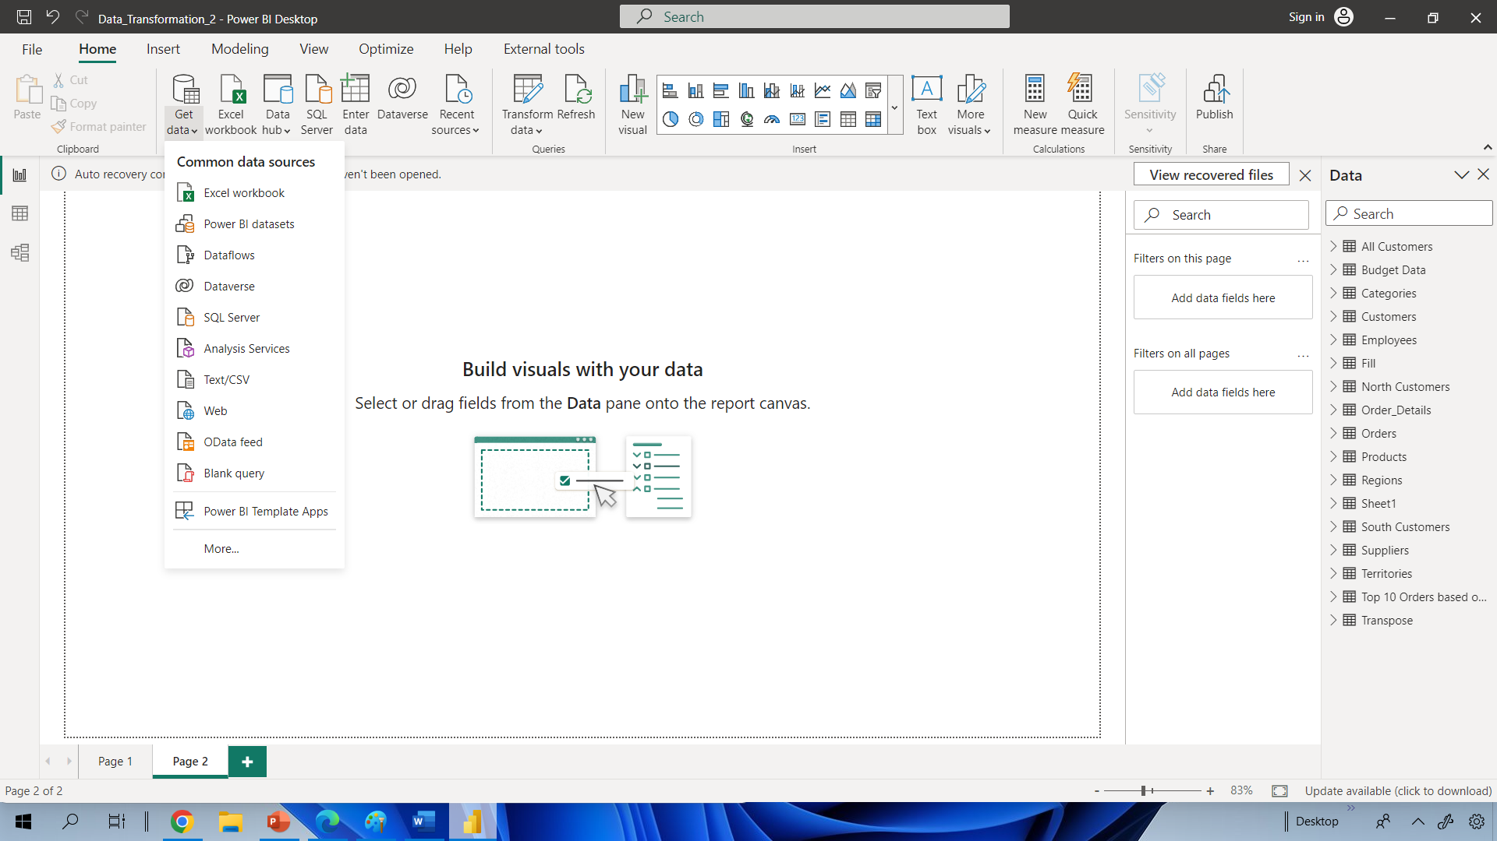
Creating a Data Flow
From now, you can in Power Bl Desktop select this Data Flow as a data source and use
it as any other source.

Slide 17
Advantages of Power Bl Data Flow
4 Benefits of Using MS Power BI Dataflows
Team collaboration
Enable team collaboration while building your data retrieval & preparation processes.
Eliminate duplication of data retrieval processes
Ensure data retrieval has a minimal and consistent impact on your applications.
Provide a consistent "single source of truth"
guild reports and visualizations on top of a single source of truth.
Integrated Common Data Model schemes
Map your organization’s data to the Common Data Model quickly and easily.

Slide 18
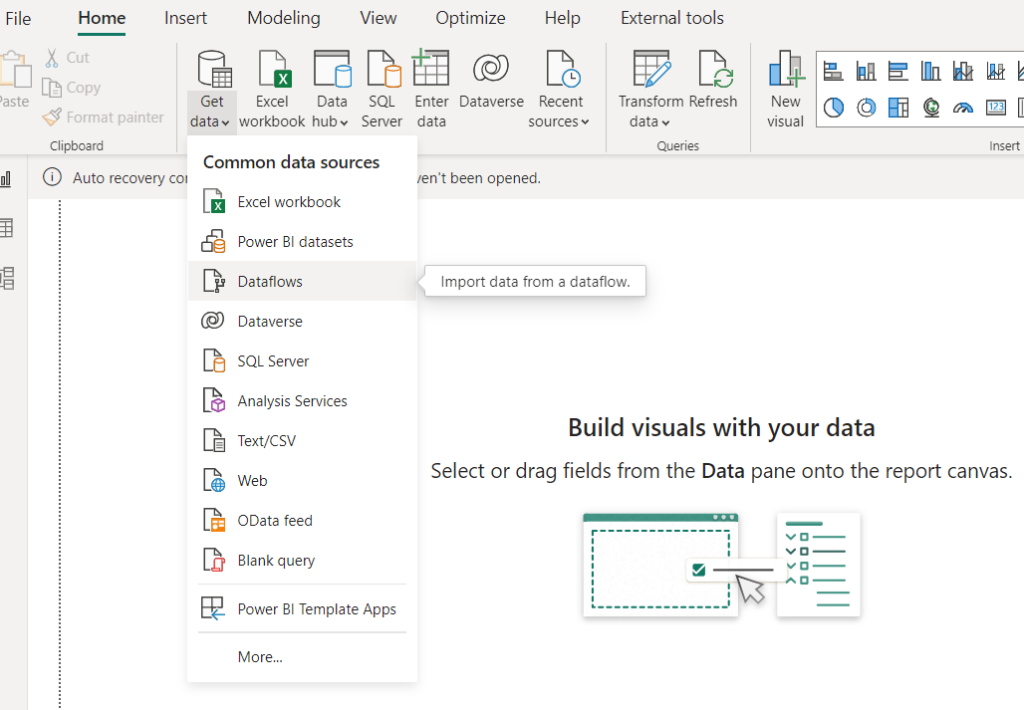
Create report using Data Flow
A dataflow can be consumed in the following three ways:
1. Create a linked table from the dataflow to allow another dataflow author to use the data.
2. Create a dataset from the dataflow to allow a user to utilize the data to create reports.
3. Create a connection from external tools that can read from the CDM format.

Slide 19
Data Flow Demo

Slide 20
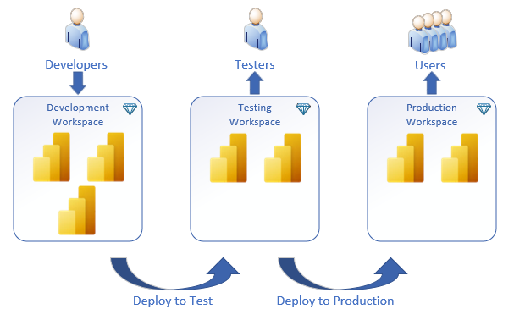
Introduction of Deployment Pipelines
Deployment pipelines helps enterprise Bl teams build an efficient and reusable release process by maintaining development, test, and production environments.
During deployment, Power Bl copies the content from the current stage, into the target one.
Deployment pipelines is a Premium feature.

Slide 21
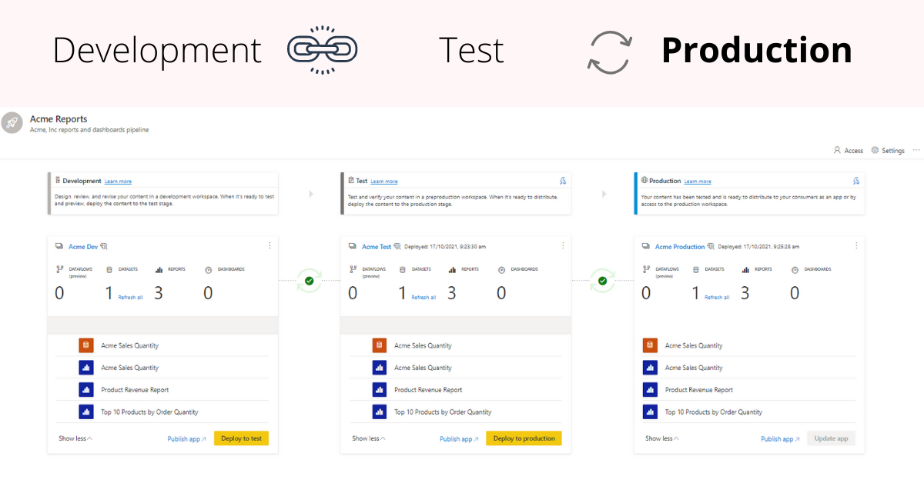

Slide 22
Benefits of Deployment Pipelines
Bl teams adopting deployment pipelines, will enjoy:
Improved productivity
Faster content updates delivery
Reduced manual work and errors

Slide 23
Demo of Deployment Pipelines

Slide 24
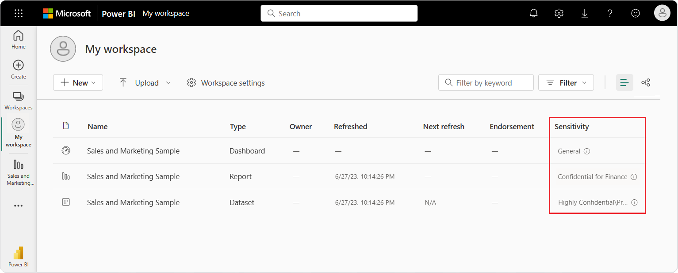
Introduction of Sensitivity Labels in Power Bl
Microsoft Information Protection sensitivity labels on your reports, dashboards, datasets, dataflows, and .pbix files can guard your sensitive content against unauthorized data access and leakage.
Labelling your data correctly with sensitivity labels ensures that only authorized people can access your data.
You can apply sensitivity labels in the Power Bl service & Power Bl Desktop.

Slide 25
Introduction of Power Bl Goals Feature
Organizations exist to achieve business objectives and in todays data driven world, we know that progress is measured through data.
However, this is often challenging as goal tracking systems are disconnected from your business data and often require manual updates.
Not only that, but goals need to be optimized for teamwork, tightly integrated into core business processes, and easily extended.

Slide 26
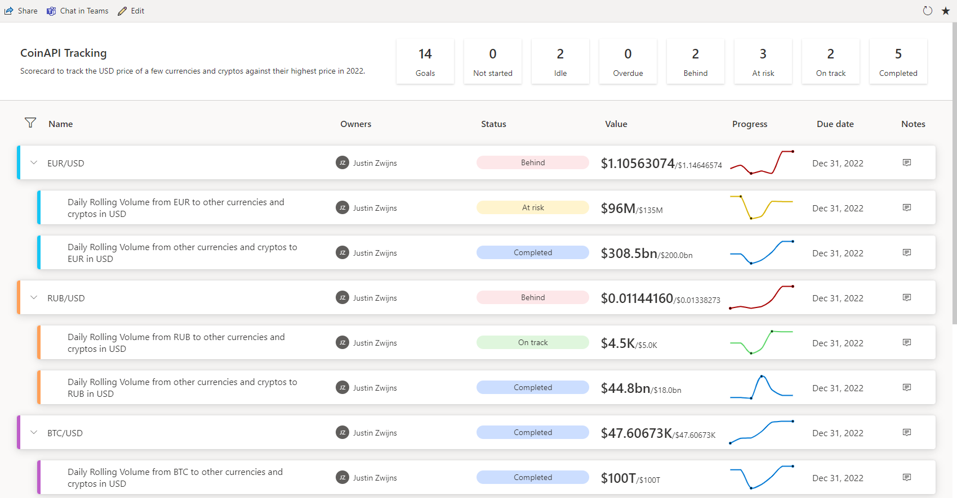

Slide 27
Introduction of Power BI KPI
A Key Performance Indicator (KPI) is a visual cue that communicates the amount of progress made toward a measurable goal. For more about KPIs, see Key Performance Indicators (KPIs) in PowerPivot.
When to use a KPI
KPIs are a great choice:
To measure progress. Answers the question, "What am I ahead or behind on?"
To measure distance to a goal. Answers the question, "How far ahead or behind am I?"

Slide 28
